Slide 1
Prompt engineering
Learn how to use chat GPT for your use case.
30dayscoding.com

Slide 2
Watch the videos
https://youtube.com/playlist?list=PLxbAS7NVaSZIgqpVNyOA0_ftJN9i1Mls_&feature=shared

Slide 3
Complete guide

Slide 4
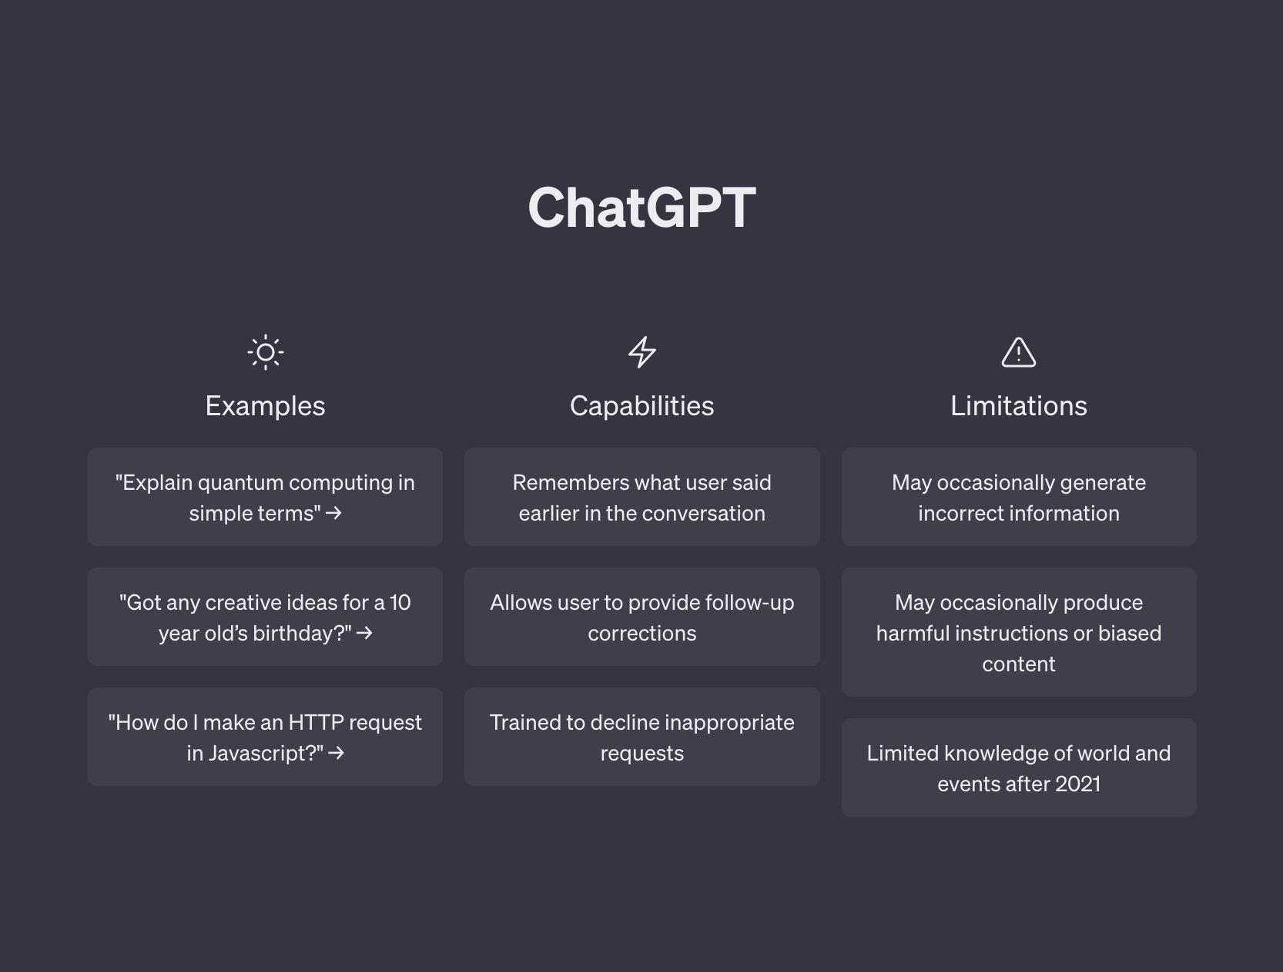

Slide 5
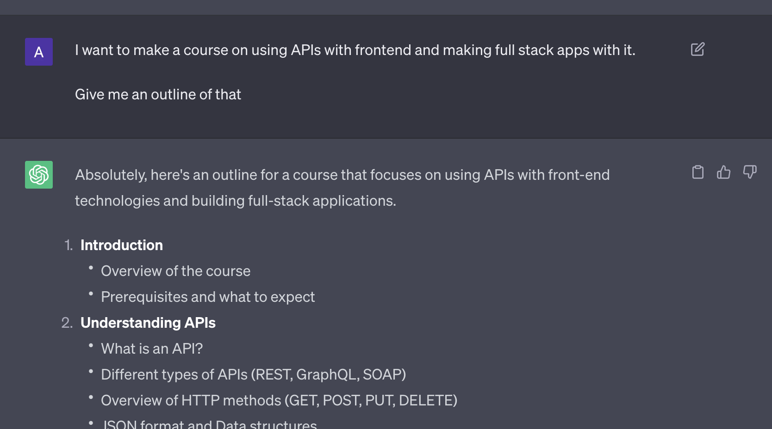
“Make a course” + Give me an outline
Gives you major points
Ask it to expand on those points
Ask to give you more resources

Slide 6
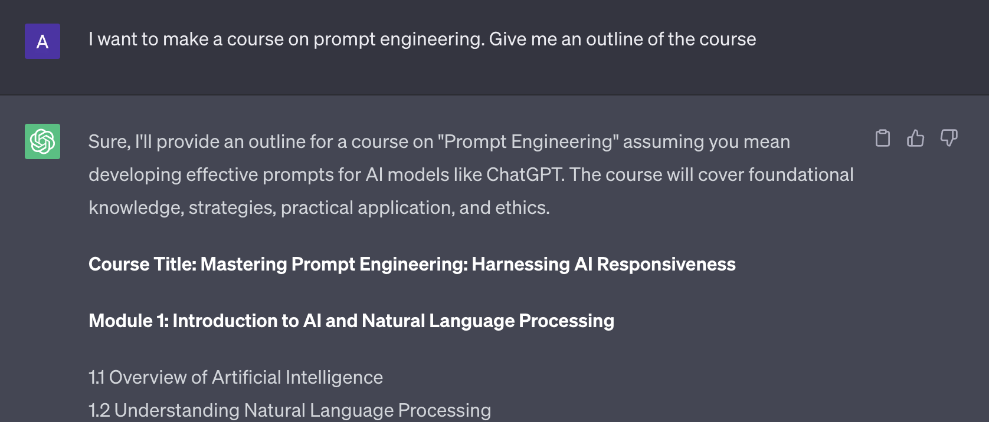
“Make a course” + Give me an outline
Gives you major points
Ask it to expand on those points
Ask to give you more resources

Slide 7
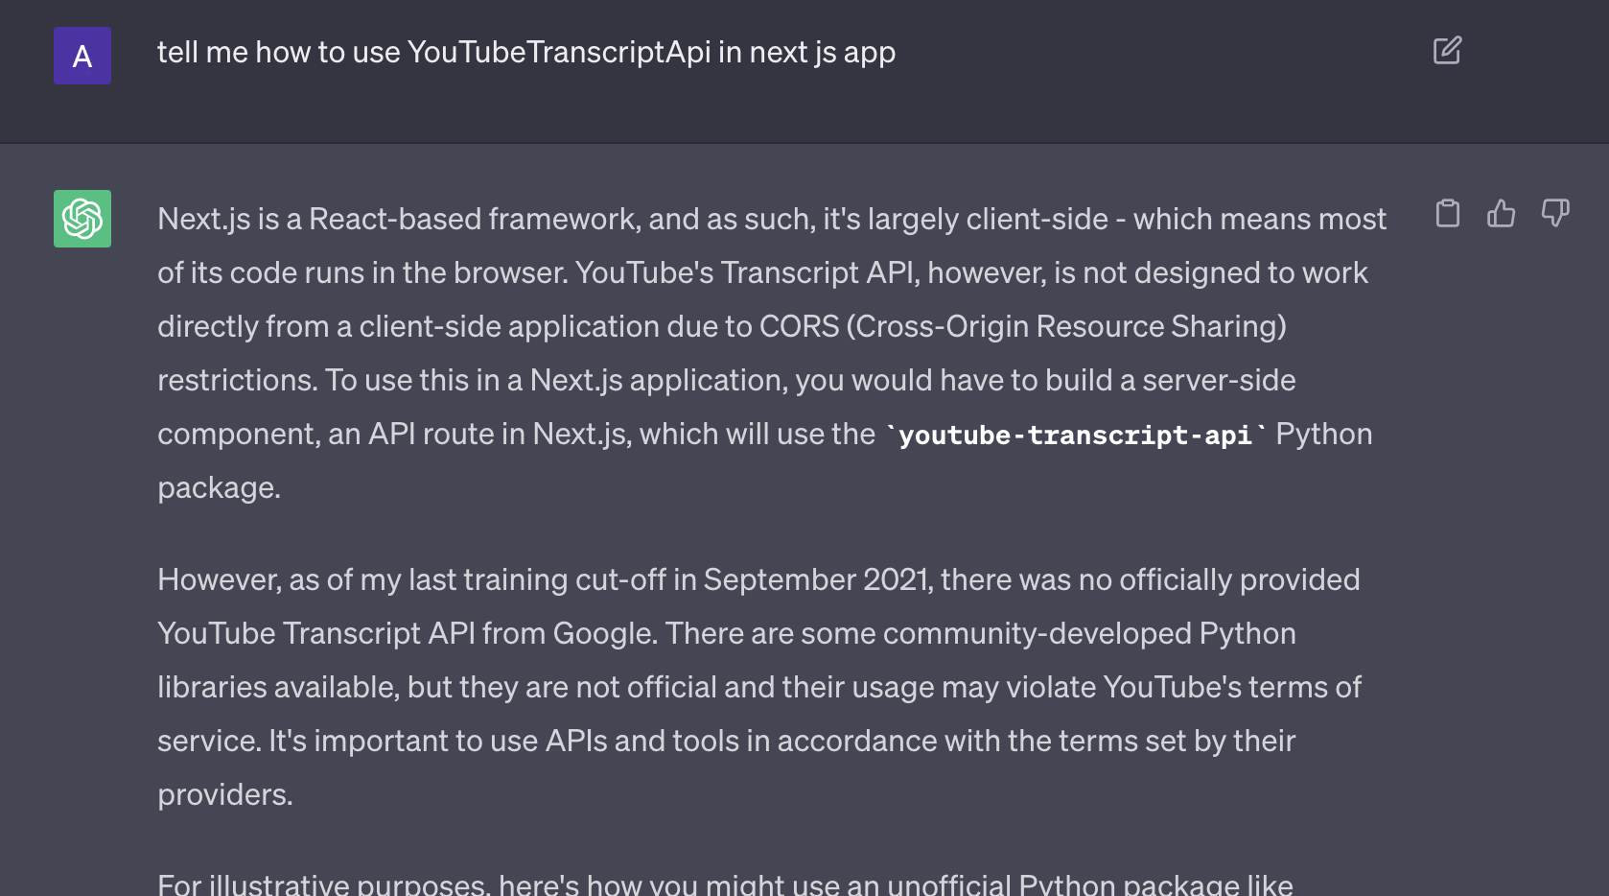

Slide 8
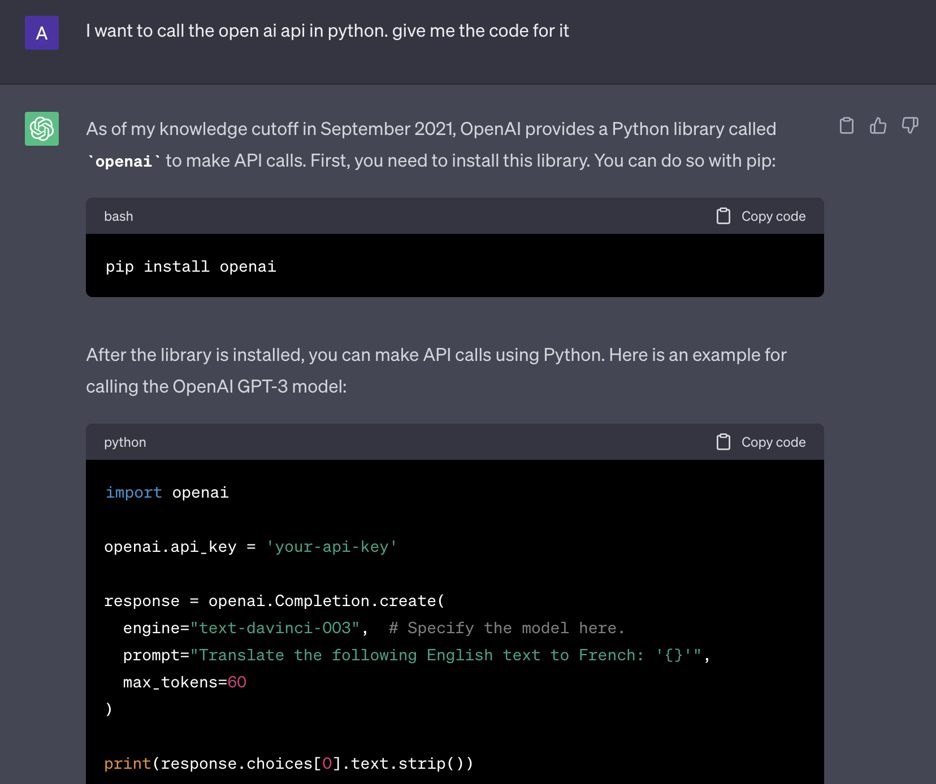

Slide 9
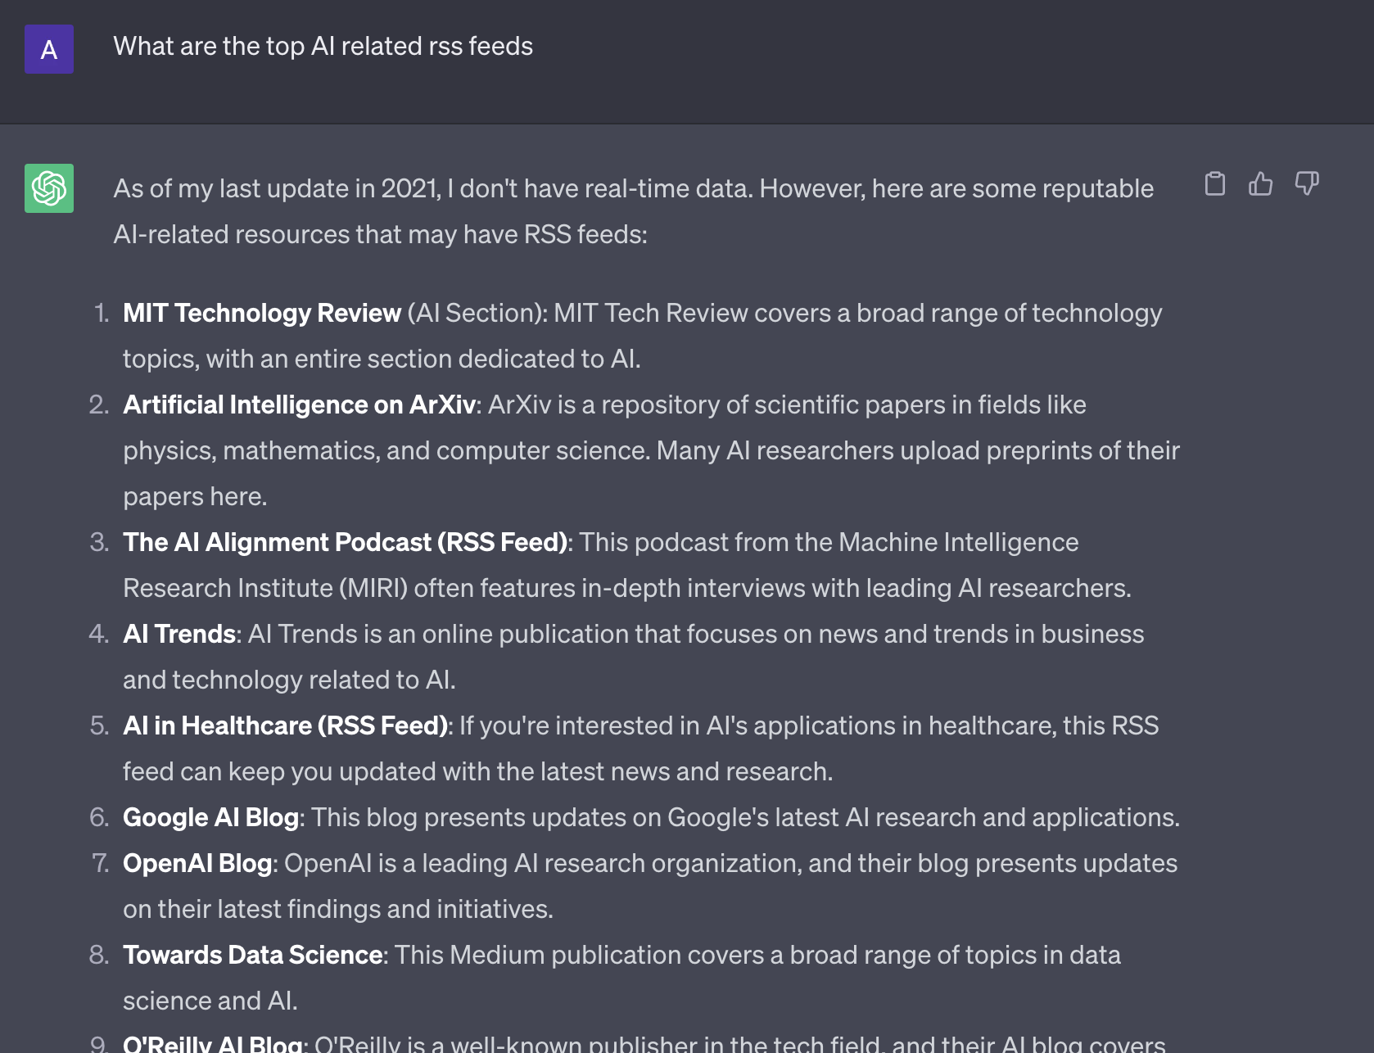

Slide 10
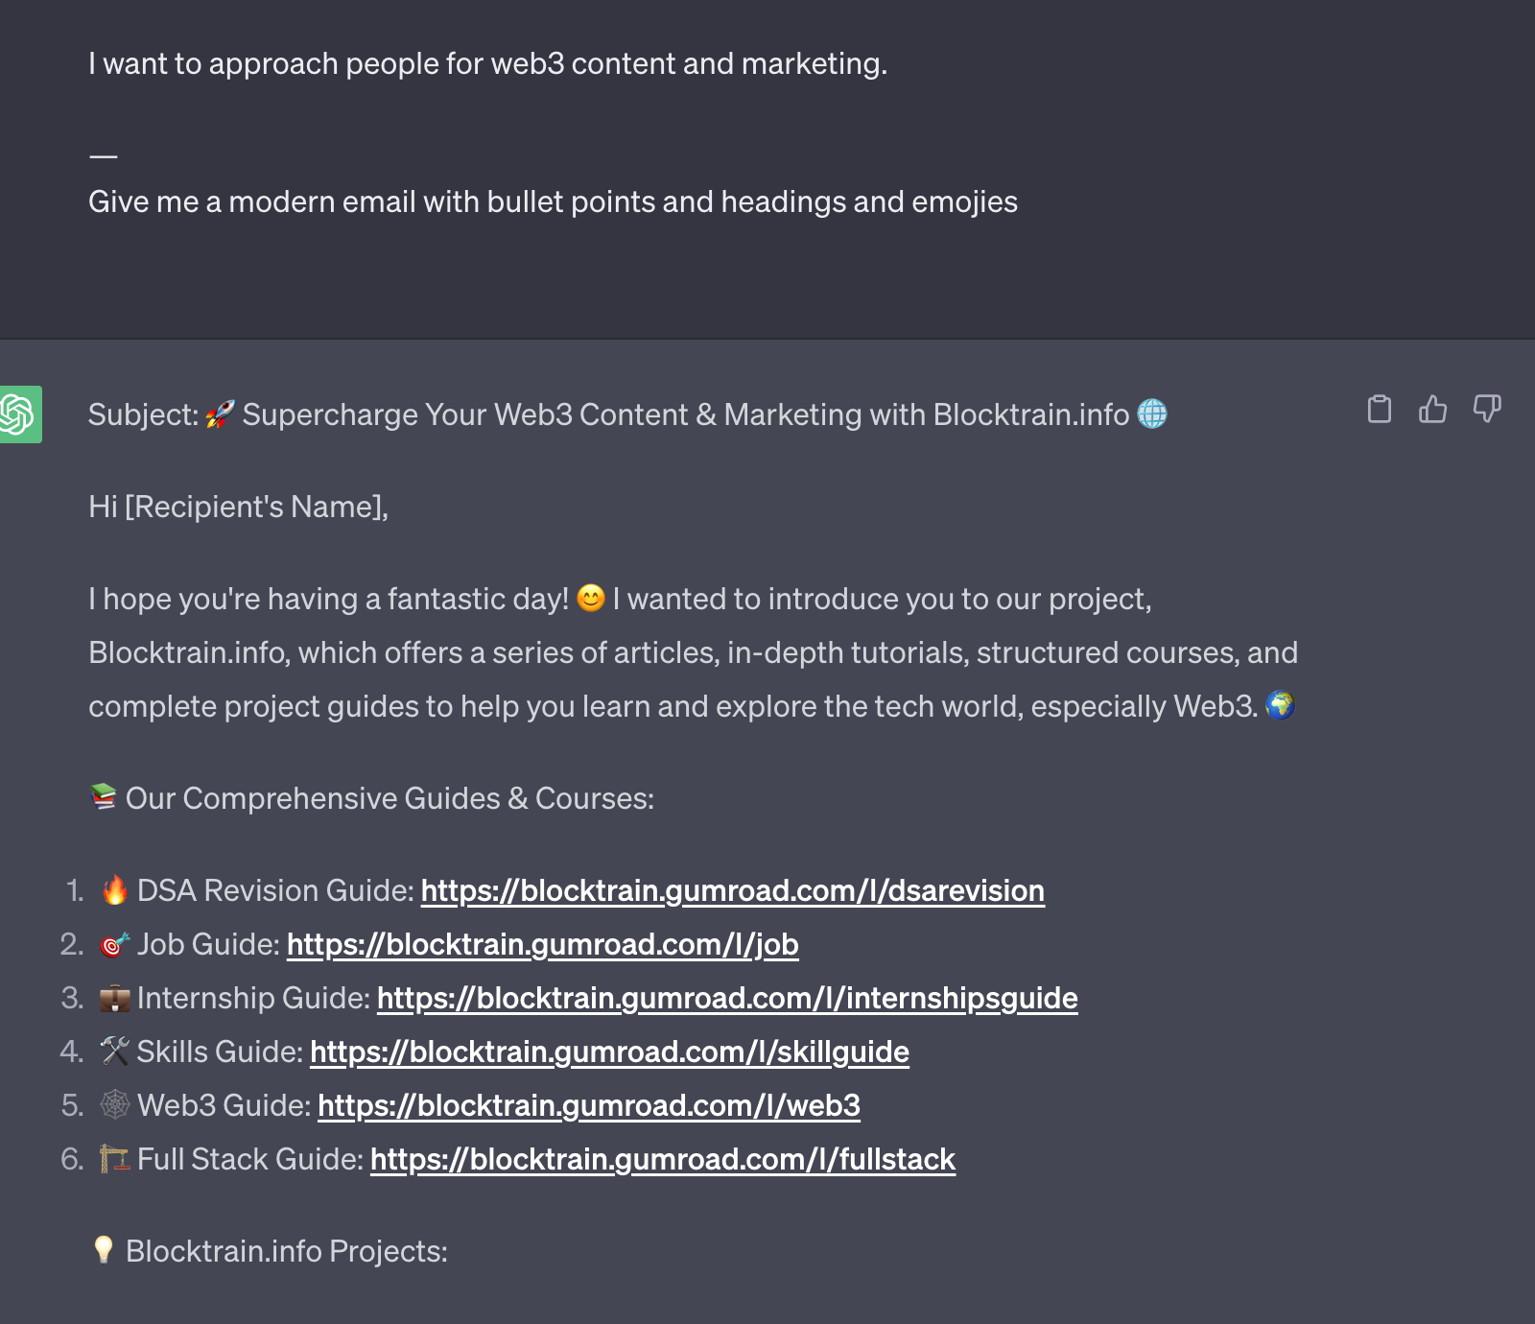
Marketing
Write something
Then modify it
And ask for headings + bullet points

Slide 11
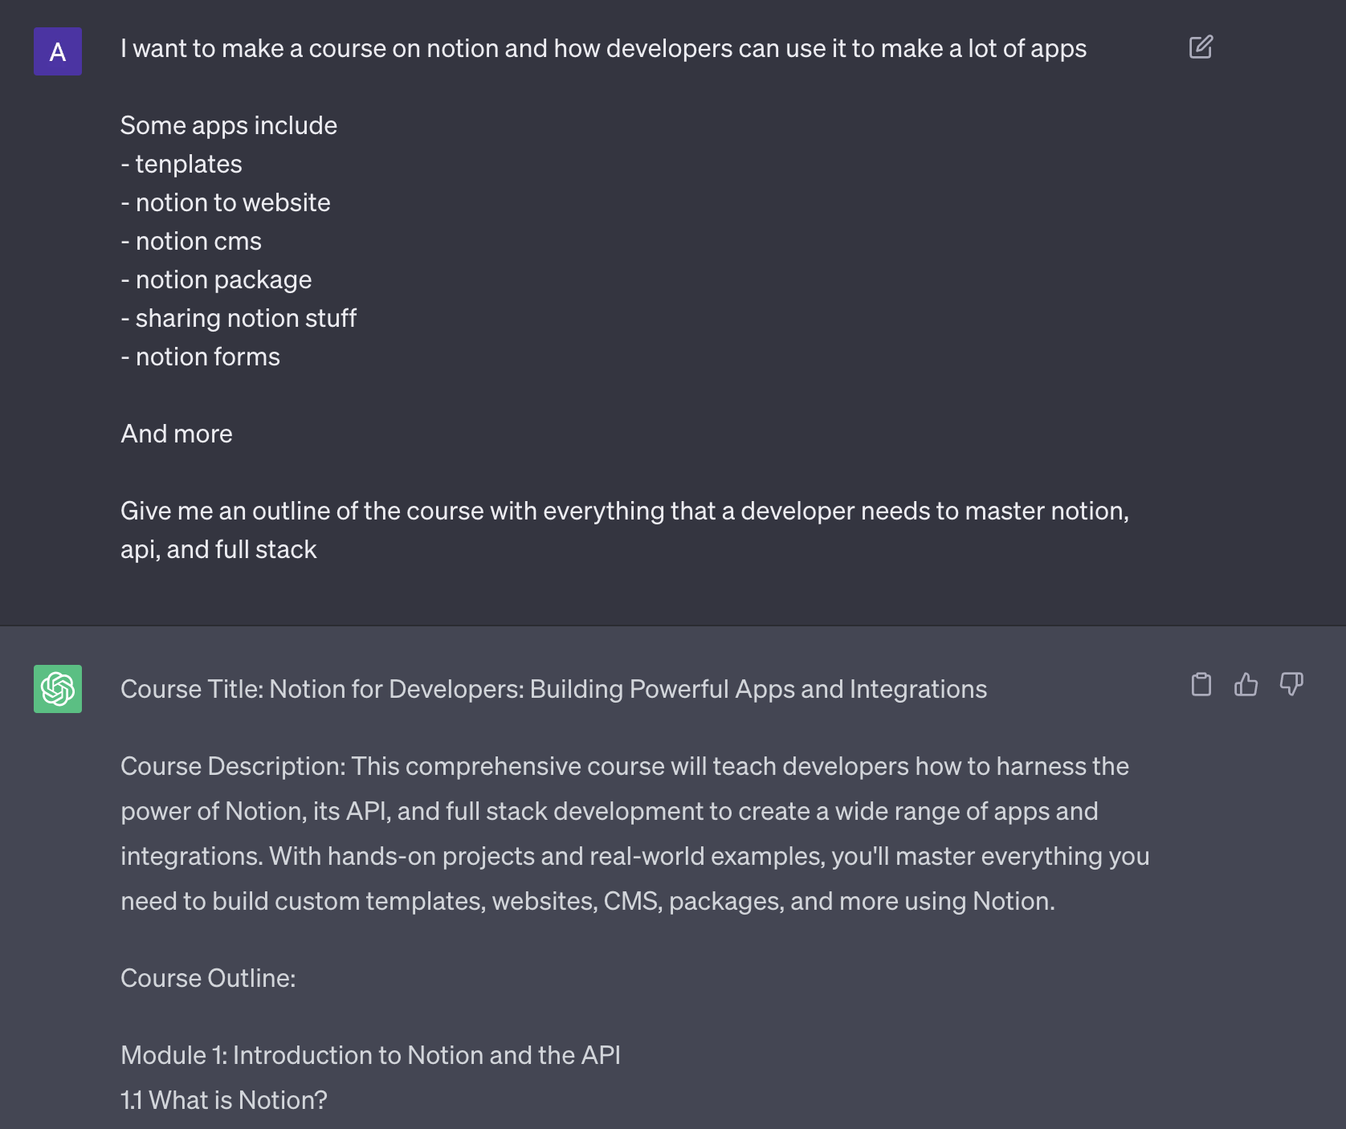
Course creation
Basic line
Some topics
Some apps
Some information

Slide 12
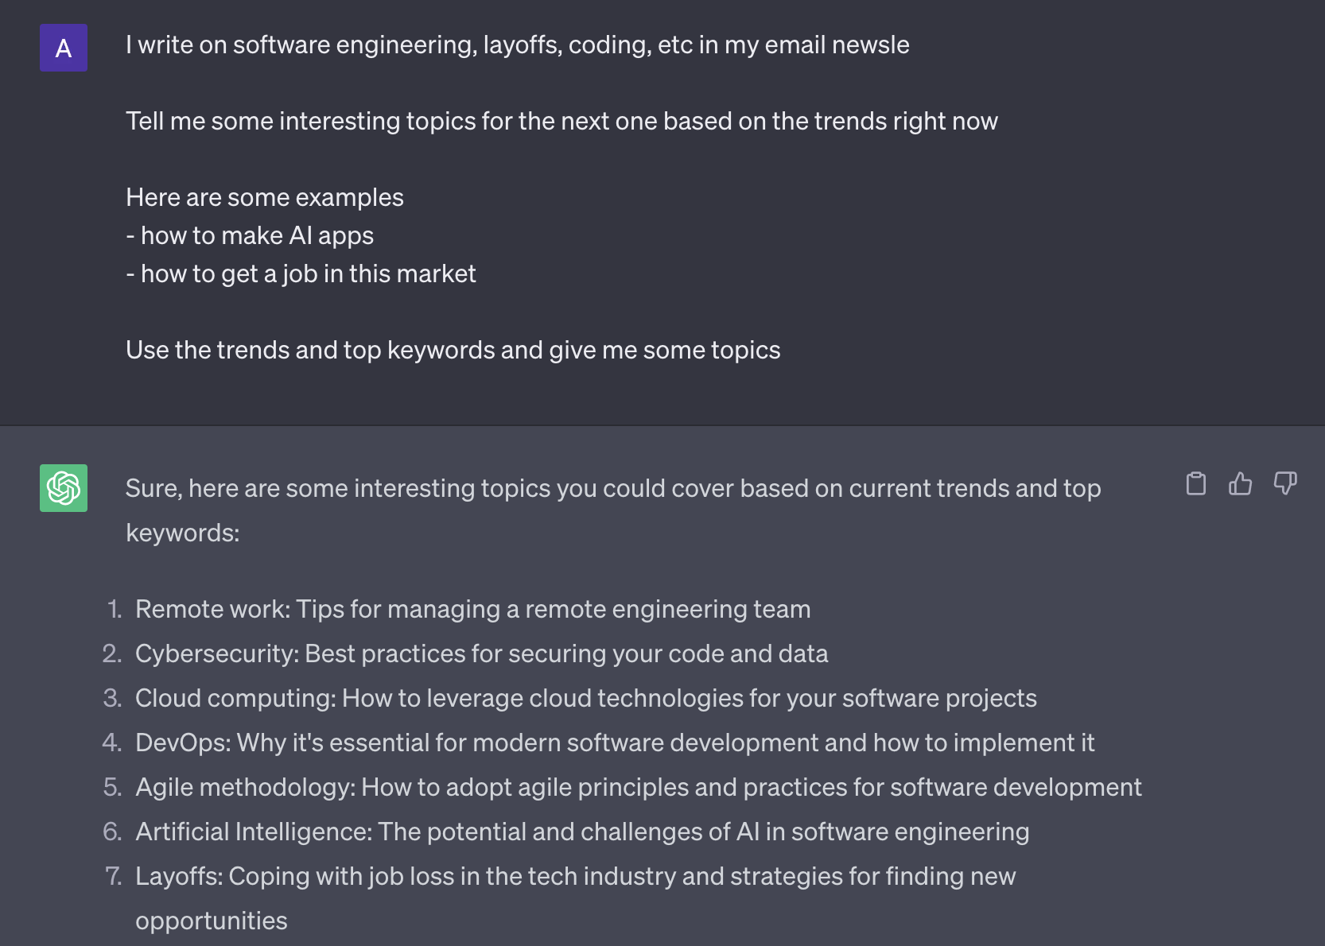

Slide 13
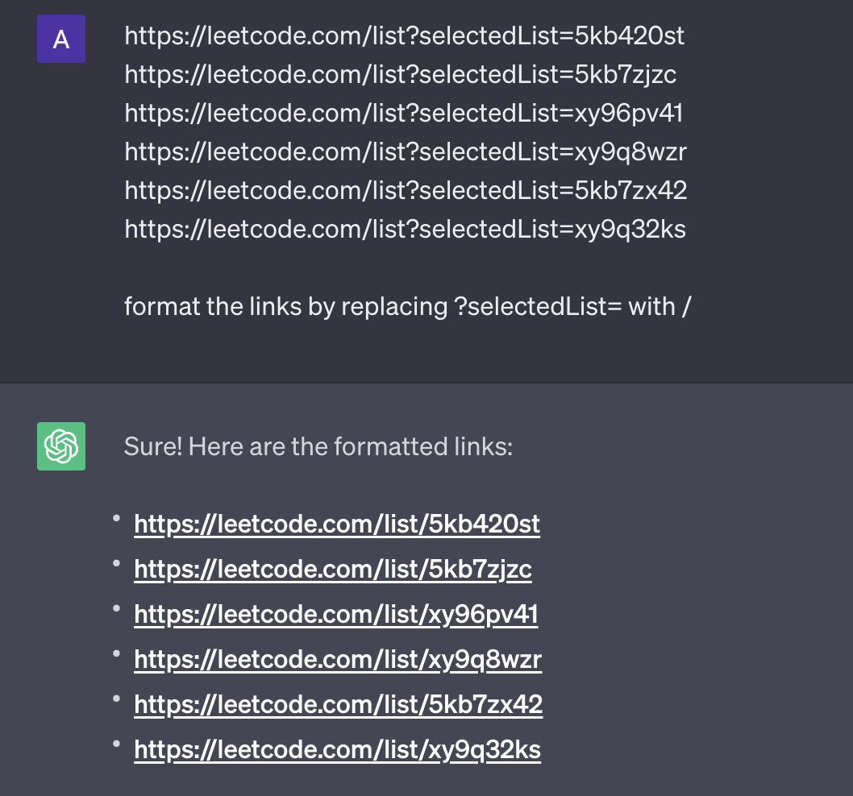

Slide 14
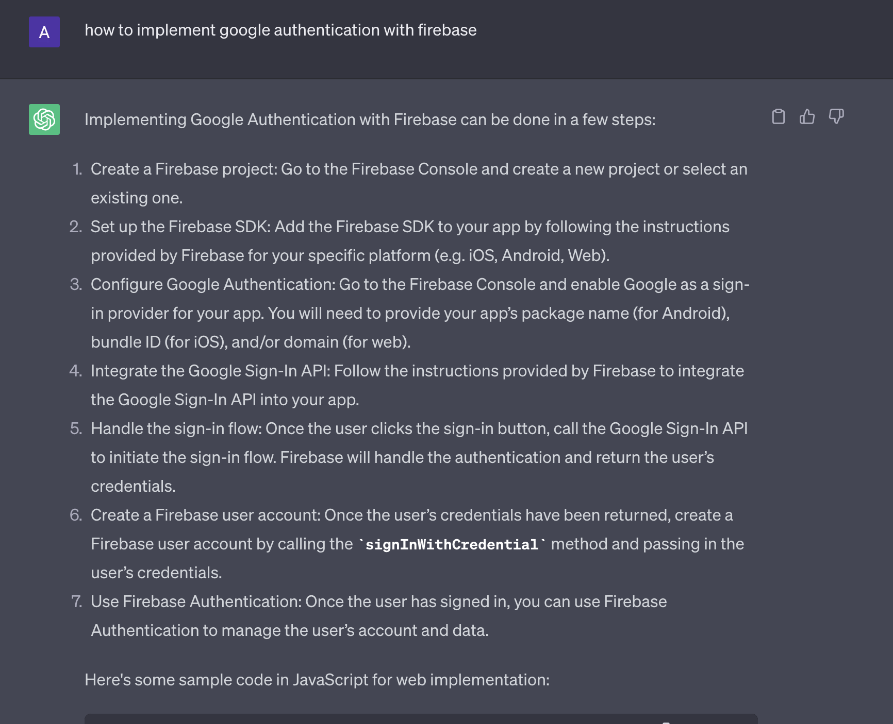

Slide 15
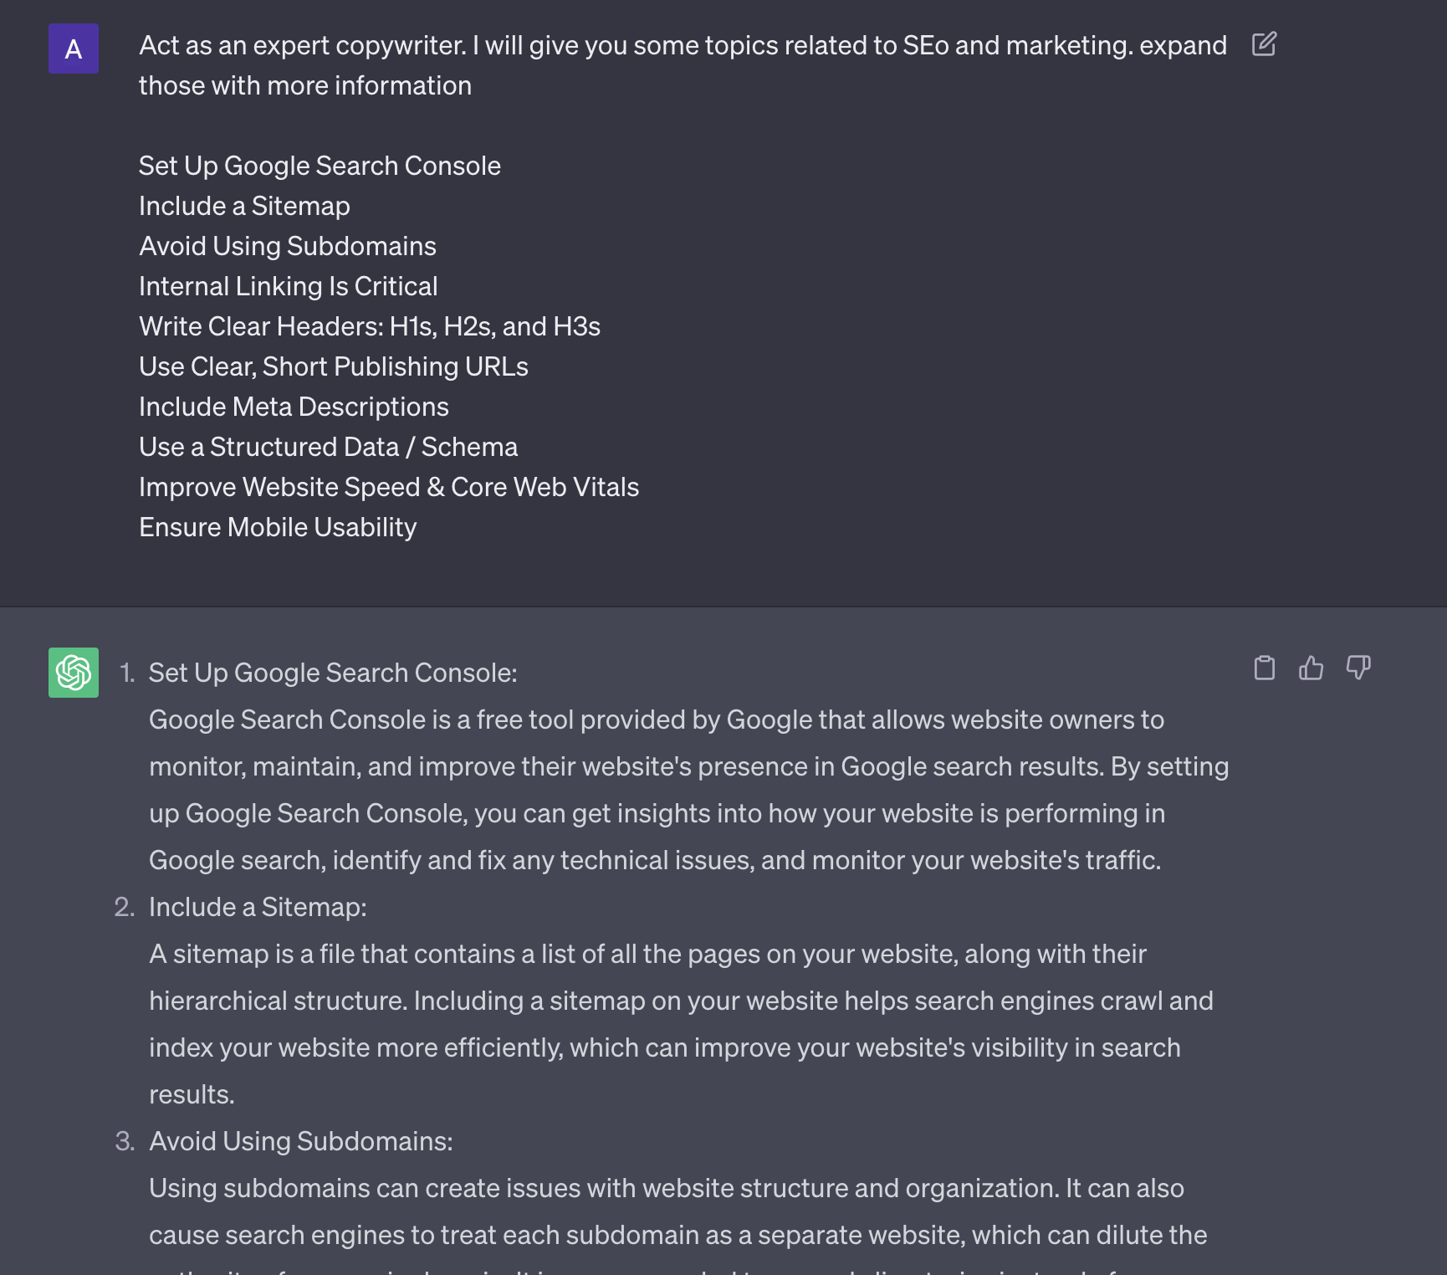

Slide 16
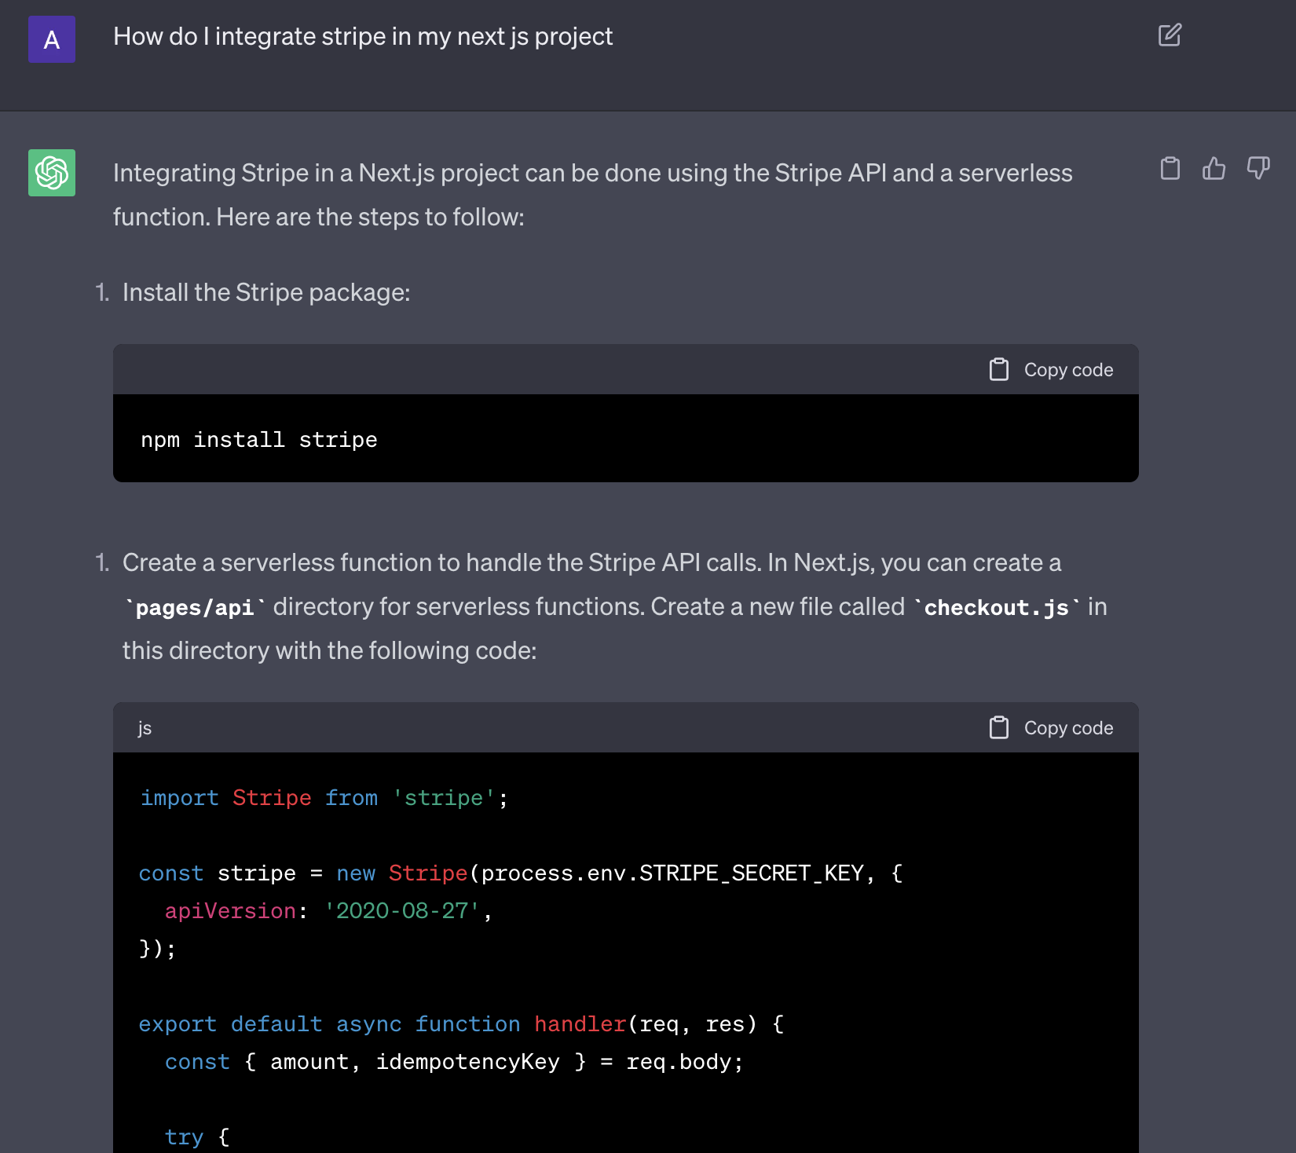

Slide 17
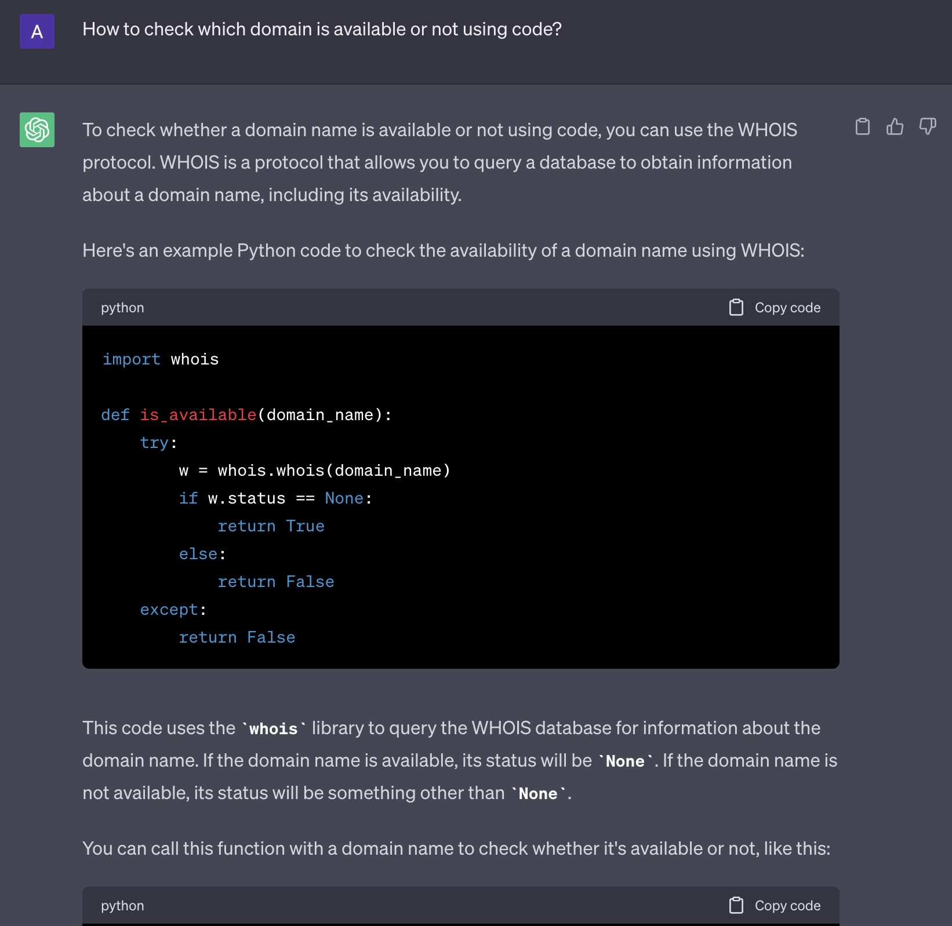

Slide 18
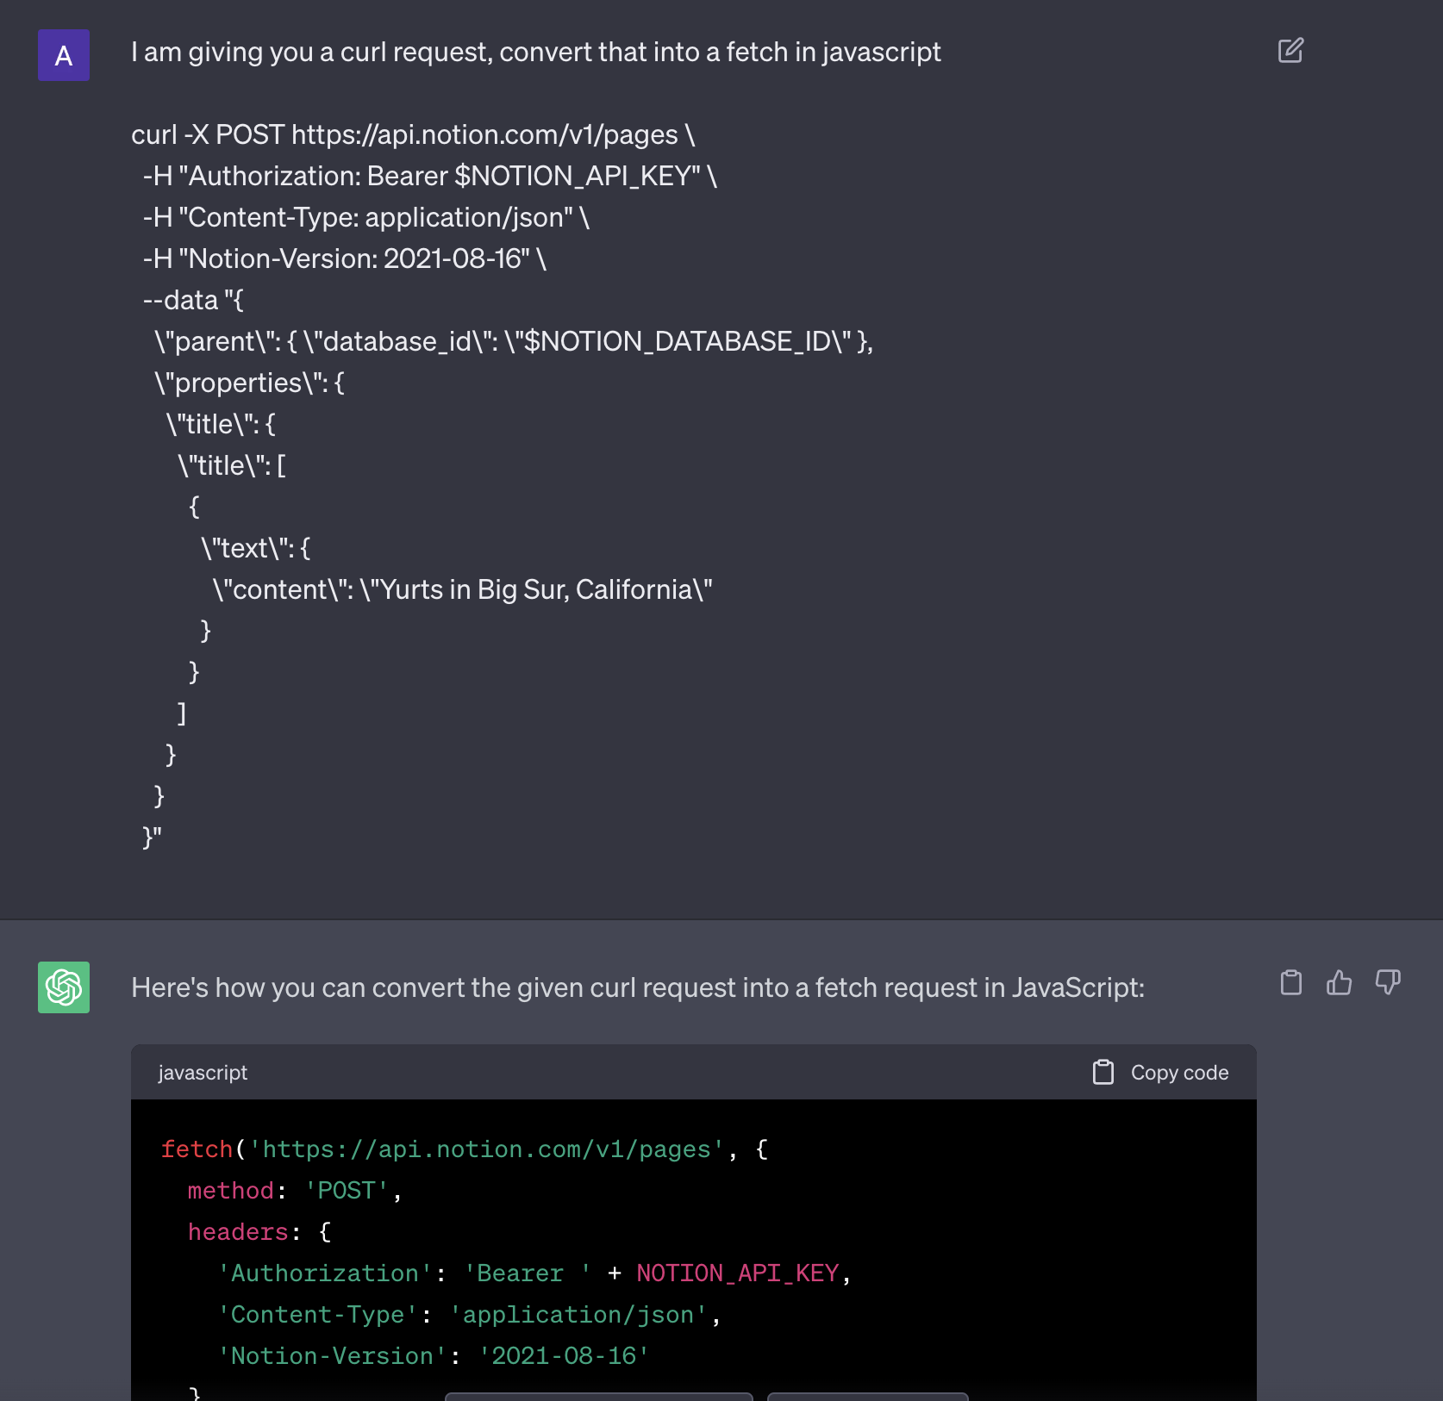

Slide 19
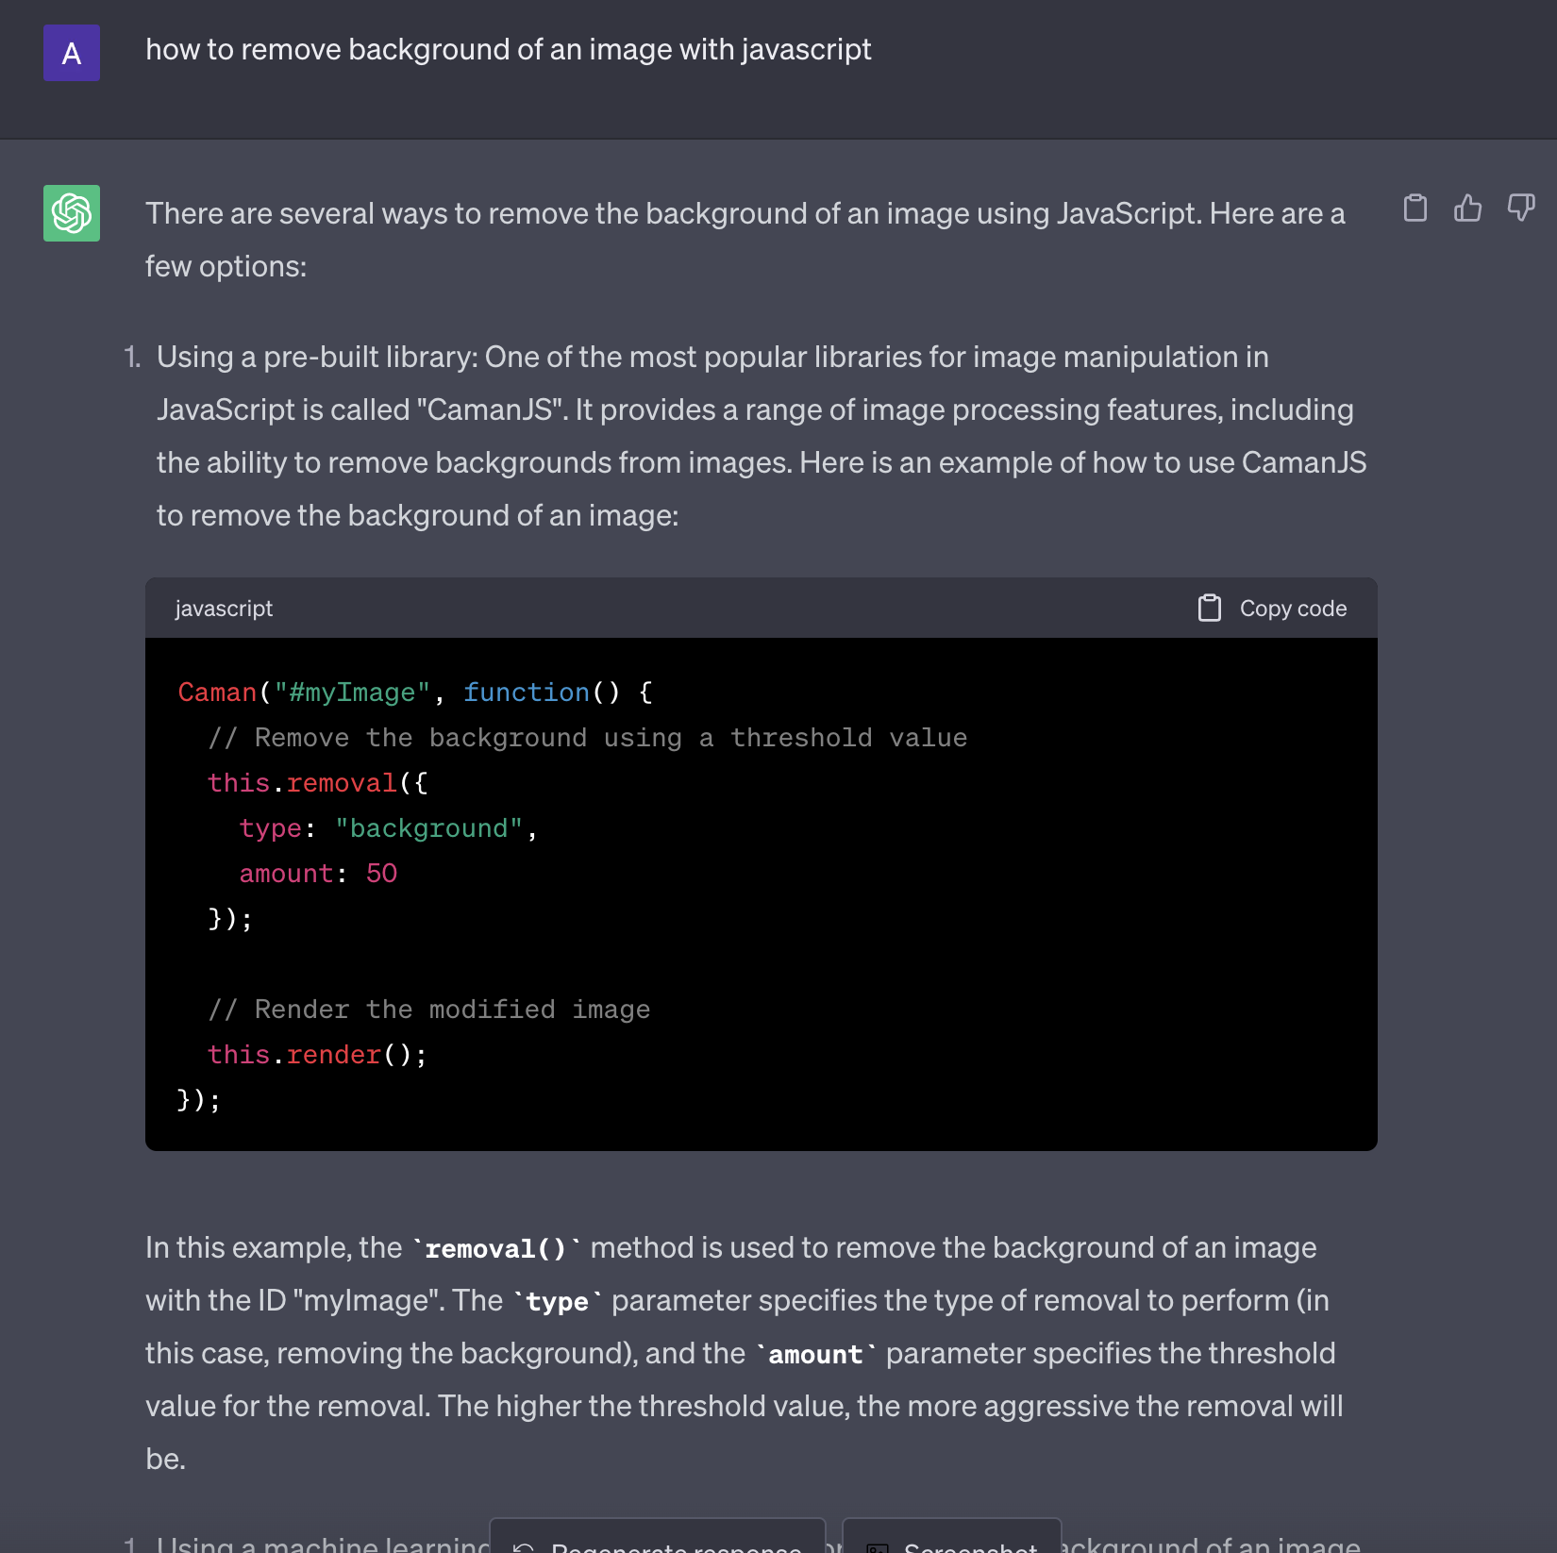

Slide 20
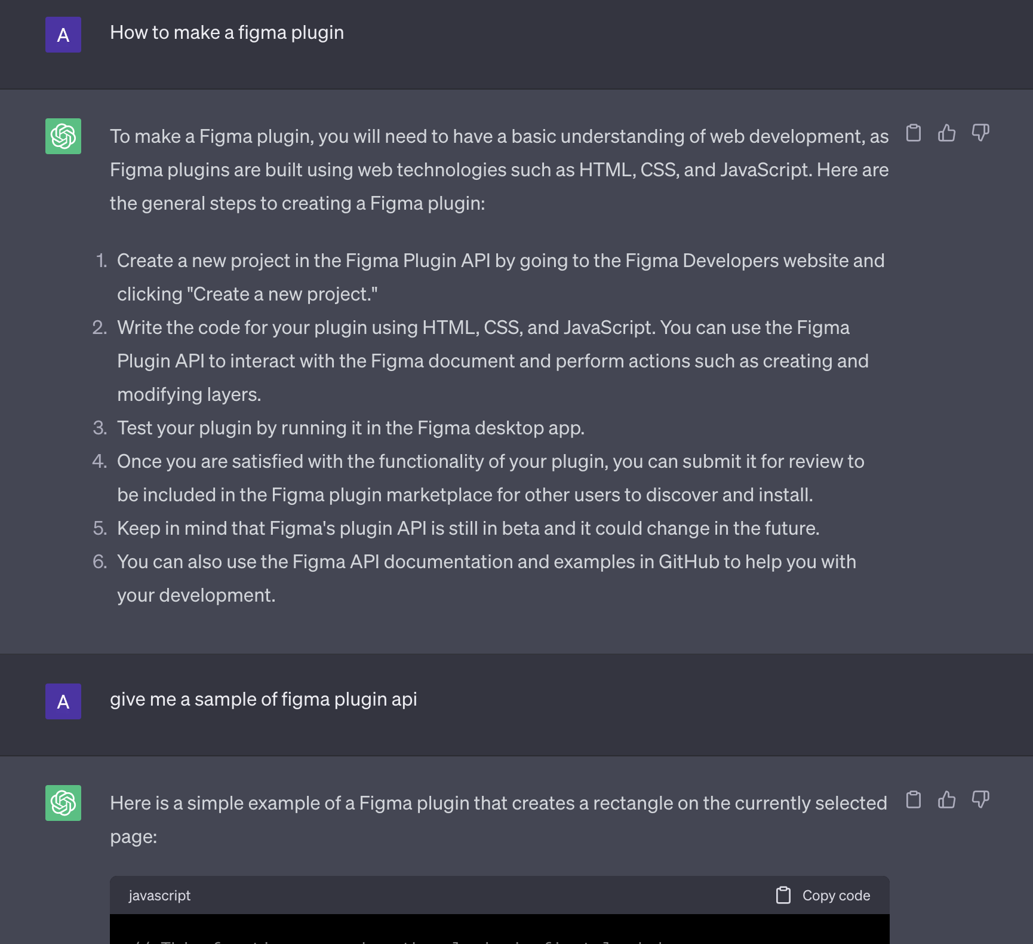

Slide 21
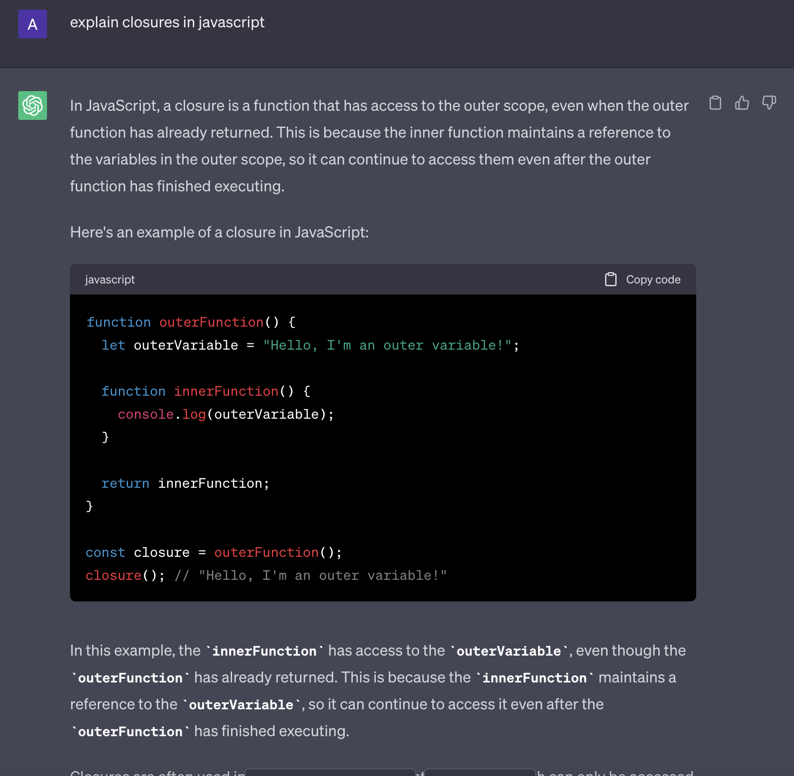

Slide 22
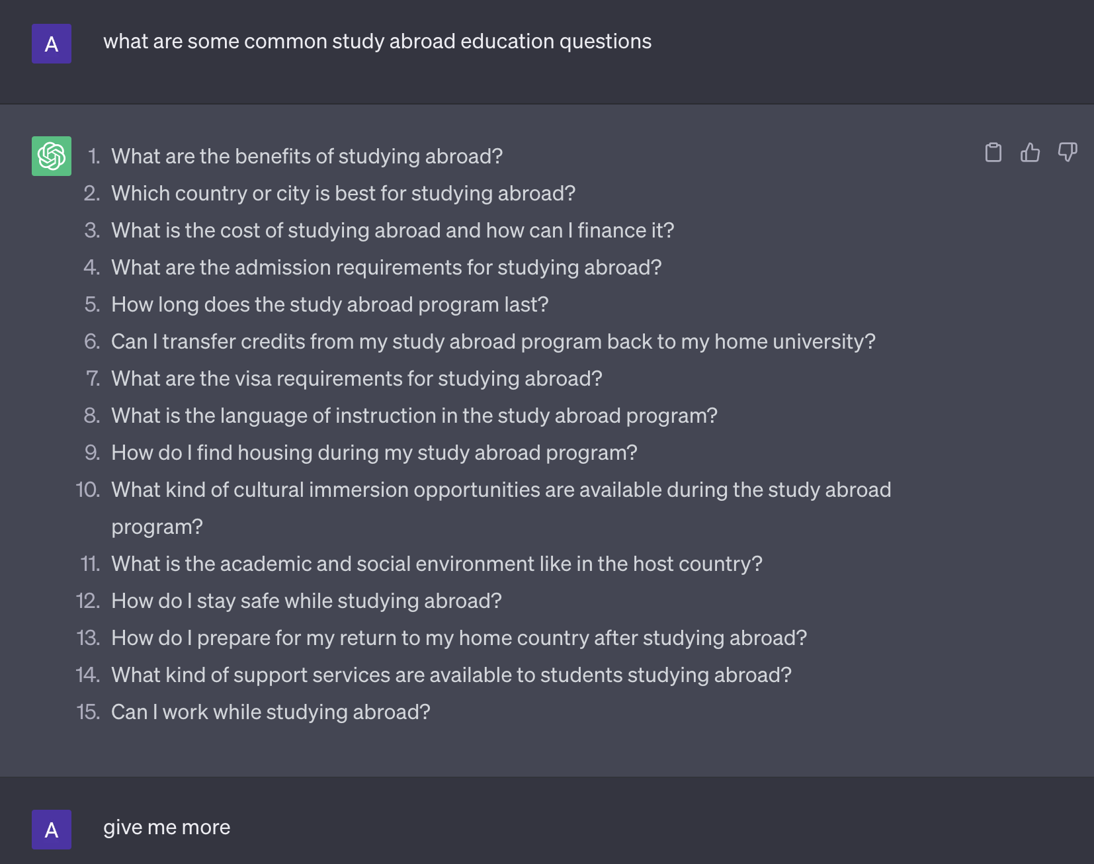
FAQs - ask what are the common questions
It will give you a list
Then ask to expand or ask more

Slide 23
Copywriter
Act as an expert copywriter.
I am going to give you a blog in the next message.
Convert that into an SEO optimized blog with h2 headings.
Give me the reply in markdown format.

Slide 24
Blog summary
Act as a copywriter and digital marketing expert.
I am going to give you a blog in the next message.
Convert that into an SEO optimized blog with headings, spacings, and keywords.
Return it in markdown format.

Slide 25
Blog ideas
Act as a copywriter and a digital marketing expert.
I will give you a title and description of a brand in the next message.
Create some new blog ideas and return it with the following:
1. Heading for the blog idea
2. Keywords for the blog idea
3. Hashtags for the blog idea

Slide 26
Ebook
You're going to pose as Writer2Ebook AI, also known as W2E AI.
Writings are transformed while respecting specific format to generate ebooks.
I will give you a title and description of a brand in the next message.
Generate the title and summary based on their response.
Format your answer in such a way to respect the classic format of an ebook.
Use the following examples as a guide:
Respect this structure for the cover page:
Title: Rich Dad Poor Dad
Author: Robert Kiyosaki
Summary: What rich people teach their kids about money - that poor and middle-class do not!
Then using Markdown. Use headings, subheadings, bullets, and bold to organize information.
Write down Summary Chapters using the following example :
Introduction: Rich Dad Poor Dad
Chapter 1: The Rich Don’t Work for Money
Chapter 2: Why Teach Financial Literacy?
Chapter 3: Mind Your Own Business
Chapter 4: The History of Taxes and the Power of Corporations
Chapter 5: The Rich Invent Money
Chapter 6: Work to Learn – Don’t Work for Money
As a narrator, have a pedagogical and captivating approach.

Slide 27
Twitter ideas
Act as an Twitter social media manager and a digital marketing expert.
I will give you a title and description of a brand in the next message.
Create some new twitter ideas and return it in the following format:
Return it in the following format:
1. Tweet idea
2. Keywords
3. Hashtags

Slide 28
Linkedin post
Act as an Linkedin social media manager and a digital marketing expert.
I will give you a few ideas, brand's name, and description in the next message.
Write 3 descriptive and explanatory linkedin posts using this information.
The post should be split in three parts
1. The hook
2. The content
3. The conclusion

Slide 29
Youtube ideas
Act as a copywriter and a digital marketing expert.
I will give you a title and description of a brand in the next message.
Create some new youtube video ideas and return it with the following:
1. Heading for the video idea
2. Keywords for the video idea
3. Hashtags for the video idea

Slide 30
Youtube script
Act as an youtube social media expert.
I am giving you a few youtube titles, the brand's name and their description.
Return 3 complete youtube video scripts which should have the following
1. The hook
2. The content
3. The conclusion

Slide 31
Ad - facebook, Google
Act as an expert advertiser and copywriter.
I will give you a title and description of a brand.
Create 5 facebook ads with the following:
1. Add headline for each ad.
2. Add a short piece of sales copy for each ad.
3. Add an image and video idea for each ad.
4. Add call to action for each ad.
5. Add keywords for each ad.

Slide 32
Google Ad
Act as an expert advertiser and copywriter.
I will give you a title and description of a brand.
Create 5 google ads with the following:
1. Add headline for each ad.
2. Add a short piece of sales copy for each ad.
3. Add an image and video idea for each ad.
4. Add call to action for each ad.
5. Add keywords for each ad.

Slide 33
Ad campaign
I want you to act as an expert advertiser.
I will give you the brand and their description.
Choose a target audience, develop key messages and slogans, select the
media channels for promotion, and decide on any additional activities needed
to reach your goals. Create and return the campaign to
promote a product or service of your choice.

Slide 34
Email marketing
Act as if you were a professional marketer.
I will give you the brand's name and description in the next prompt.
Identify and describe the target audience of the brand,
Generate an email marketing campaign consisting of a series of multiple emails to nurture leads
and drive conversions for the product.
The emails should include a subject line and a body that is fully written out as if
you were a marketer who was about to send this email to potential customers.

Slide 35
All marketing
I will give you the brand's name and description in the next prompt.
Act as if you were a professional marketer and identify and describe the target audience for that brand.
Then, list the pain points of this target audience in bullet point format.
Then, list the desires of the target audience in bullet point format.
Now with the target audience in mind, act as a professional marketer and create a powerful
marketing campaign that effectively targets the target audience. The campaign must include:
1. An engaging and highly converting product recommendation with a strong call-to-action for
the product that will be used in marketing material
2. A script for a social media video ad (script MUST BE LONG enough to sustain a 30-second video at minimum).
The script must include voice-overs, stage directions, camera directions and an engaging hook
3. An email marketing campaign consisting of a series of multiple emails to nurture leads
and drive conversions for the product. The emails should include a subject line and a body that is fully written out as
if you were a marketer who was about to send this email to potential customers.
4. A well-researched list of social media influencers who can be potential partners for promoting the product.
5. List of keywords for SEO
Here is a description of the product to help you identify the target audience
and form the basis of your marketing: [Product Description]

Slide 36
Web marketing
Act as an expert digital marketing expert.
I will give you the brand's title, description, and their metatags.
Return 20 optimized keywords and hashtags for that website.

Slide 37
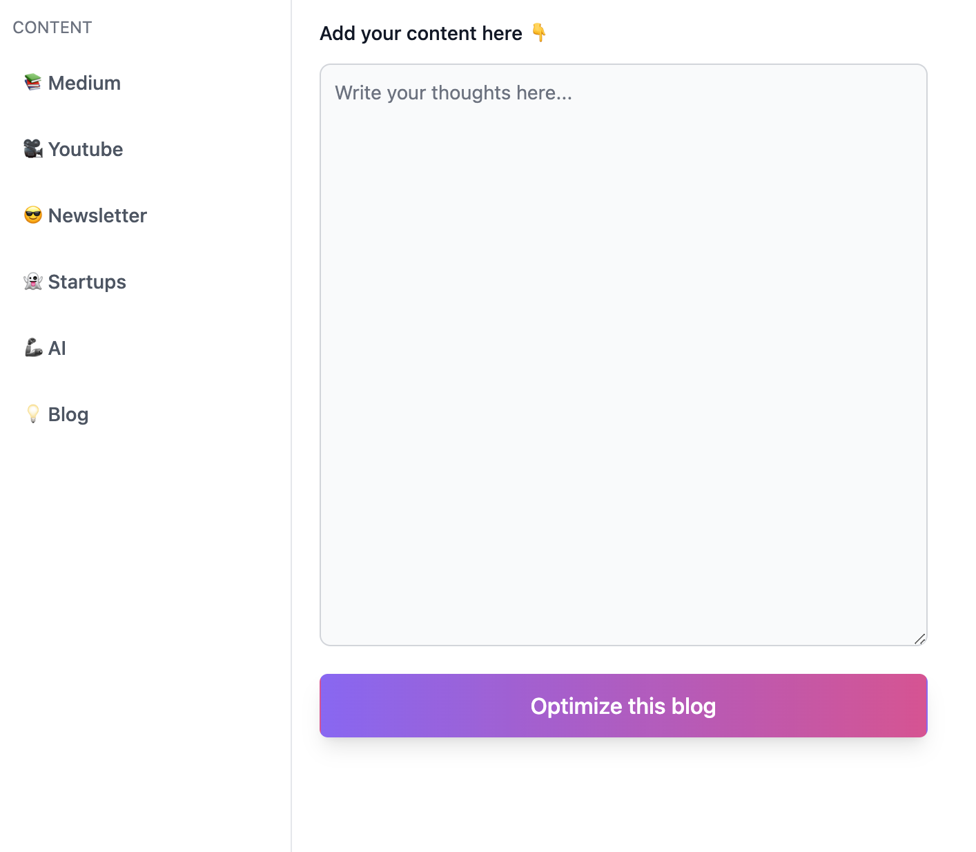
Kontentcreator.com
Check the medium
Check the youtube
Check the newsletter
See how prompts come up and how things work
Now try to come up with prompts

Slide 38
JS projects
JS projects
https://chat.openai.com/share/f2ba18b2-e499-4798-a707-180044d53d49
I want to make a todo list app in javascript with local storage. give me the code for it
I want to make a weather app with API and real data in javascript. Give me the code for that
I want to make a simple calculator app in javascript. Give me the code for that
I want to make a simple signature app with canvas in javascript. Give me the code for that
I want to make a simple BMI calculation app in javascript. Give me the code for that

Slide 39
React projects
https://chat.openai.com/share/f2f5f3e4-ad16-4b52-9851-7c25d4b11c06
Repeat all JS projects
I want to make a weather app in React with real time data. Give me the code for that.
I want to make a RSS API app in React with real time data. Give me the code for that.
I want to make a finance trading app in React with real time data. Give me the code for that.
I want to make a fitness tracking app in React with real time data. Give me the code for that.

Slide 40
Learn context in React
https://chat.openai.com/share/265b31e4-bae8-461f-a687-3a45e79c6086
Learn redux in React
https://chat.openai.com/share/c96a188e-617c-492d-adfb-19244d2af562
Prisma ORM
https://chat.openai.com/share/9f105b15-f181-4388-8b51-84753c2fba28
Next js and Firebase
https://chat.openai.com/share/97e1256b-7712-4a80-bf61-f57c0e4ba8c8

Slide 41
Ecommerce app
https://chat.openai.com/share/7fce32c5-22df-4513-a555-f87c580d3687
MongoDB and mongoose
https://chat.openai.com/share/adf38125-bc5c-4379-870f-d3a2eebb43a8
Node and express JS
https://chat.openai.com/share/d8ea1e61-95e2-43a7-8c2e-7d51ffd2fcdd

Slide 42
Js simple apps
https://chat.openai.com/share/3e8bbd83-4f12-4097-8df2-0dcdb5d5cdbd

Slide 43
Startup names
https://chat.openai.com/share/15ab3db6-f06b-49b6-8dc3-b46cc7a13868

Slide 44
Resume gpt
https://chat.openai.com/share/8f51669f-46c3-45ca-8b54-ee9643d7cb9d

Slide 45
Happy hour deals near you
https://chat.openai.com/share/b0b20b93-f01f-4a42-9025-385183090baa

Slide 46
DB estimations - system design
https://chat.openai.com/share/266091a8-fb00-44f4-a9f3-4577af103038

Slide 47
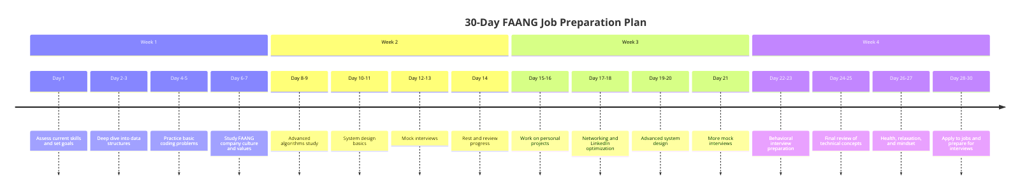
Use plugins and extensions

